Slide 1

BE A BTU HUNTER
HOW BIG DATA ANALYTICS CAN ACHIEVE ENERGY AND O&M SAVINGS WHILE IMPROVING PRODUCTIVITY, COMFORT, AND SUSTAINABILITY AT LABORATORY FACILITIES
Julianne Rhoads, EIT, CEM
& Lisa Zagura, CEM, LEED AP

Slide 2


BE A BTU HUNTER
How Big Data Analytics Can Achieve Energy and O&M Savings While Improving Productivity, Comfort, and Sustainability at Laboratory Facilities
Julianne Rhoads, EIT, CEM
& Lisa Zagura, CEM, LEED AP
Notes:
Get a sense of audience and where they’re at: BTU? Air Handler? Mixed Air Sensor? SH&C?

Slide 3
Learning Objectives
Understand how to evaluate building management system (BMS) data as a tool for identifying faults.
Understand how control strategy optimization can counter reactive maintenance.
Identify the economic and environmental benefits of big data analysis.
Recognize and appreciate high-value data points and reliable data collection.

Slide 4
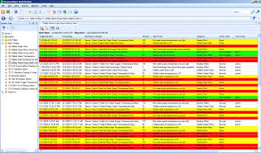
Big Data & BMS Complications
Multiple front ends & many platforms
Persistent alarms
Reactive maintenance
Minimal performance improvement
Lots and lots of data
Notes:
How organize? How prioritize? .…& leverage into a bigger positive!

Slide 5
What is Fault Detection?
Processes real time & historical data
  Point & system level
Automatically detects & prioritizes faults
  Mechanical failures
  Sub-optimal Sequence of Operations
  BMS point configuration
  Issue recurrence
Captures Predictive Maintenance
Immediately recognizes connectivity anomalies
Notes:
Move on to WHY….

Slide 6
Why Fault Detection & Analysis?
Comfort & environmental compliance
Extend equipment life
Remediated faults translate into avoided energy costs (BTU savings)
  Justification and M&V for capital projects
  Support sustainability goals & utility incentives

Slide 7
What is a BTU?
British thermal unit (Btu or BTU) is a traditional unit of heat; it is defined as the amount of heat required to raise the temperature of one pound of water by one degree Fahrenheit at a constant pressure of one atmosphere (calculated in energy units).
BTU × commodity = $$
Wikipedia. (30 July 2018, at 10:26 (UTC)). British thermal unit. https://en.wikipedia.org/wiki/British_thermal_unit#Definitions.
Notes:
BTU = Energy => convert units & multiply by cost of a commodity = dollars
Energy multiply by an emissions factor = CO2 mitigation

Slide 8
BTU = Energy
BTU = 1.08 × ΔT × Flow × Hrs
temperature differential
air flow
TMY3 hours
Notes:
Hrs of operation typical meteorological temperatures defined by NREL or TMY3 hours:

Slide 9
BTU Hunting - Air Handling Unit (AHU)
Outdoor Air Temp sensor
Heating Discharge Temp sensor
Discharge Temp sensor
Heating Coil
Cooling Coil
Supply Fan
Outdoor Air
or
Mixed Air
Supply Air
Heating Coil Valve
Cooling Coil Valve
Notes:
Air & temp: Largest & most common air system is an AHU.
Capture temperature differential to calc BTUs

Slide 10
Fault Source
Healthcare and research facility
6 buildings
2.1 million square feet
59,306 BMS points
118 air handlers
> 50 fume hoods
Monitoring period September 2015 to present
Notes:
Target Rich environment (ideal big campus, lots of older equipment)

Slide 11
ANSI/ASHRAE/IES Standard 90.1-2010, Section 6.5.2
Simultaneous Heating & Cooling Limitation
Zone thermostatic controls shall prevent:
  a. Reheating
  b. Recooling
  c. Mixing or simultaneously supplying air that has been previously mechanically heated and air that has been previously cooled, either by mechanical cooling or by economizer systems; and
  d. Other simultaneous operation of heating and cooling systems of the same zone

Slide 12
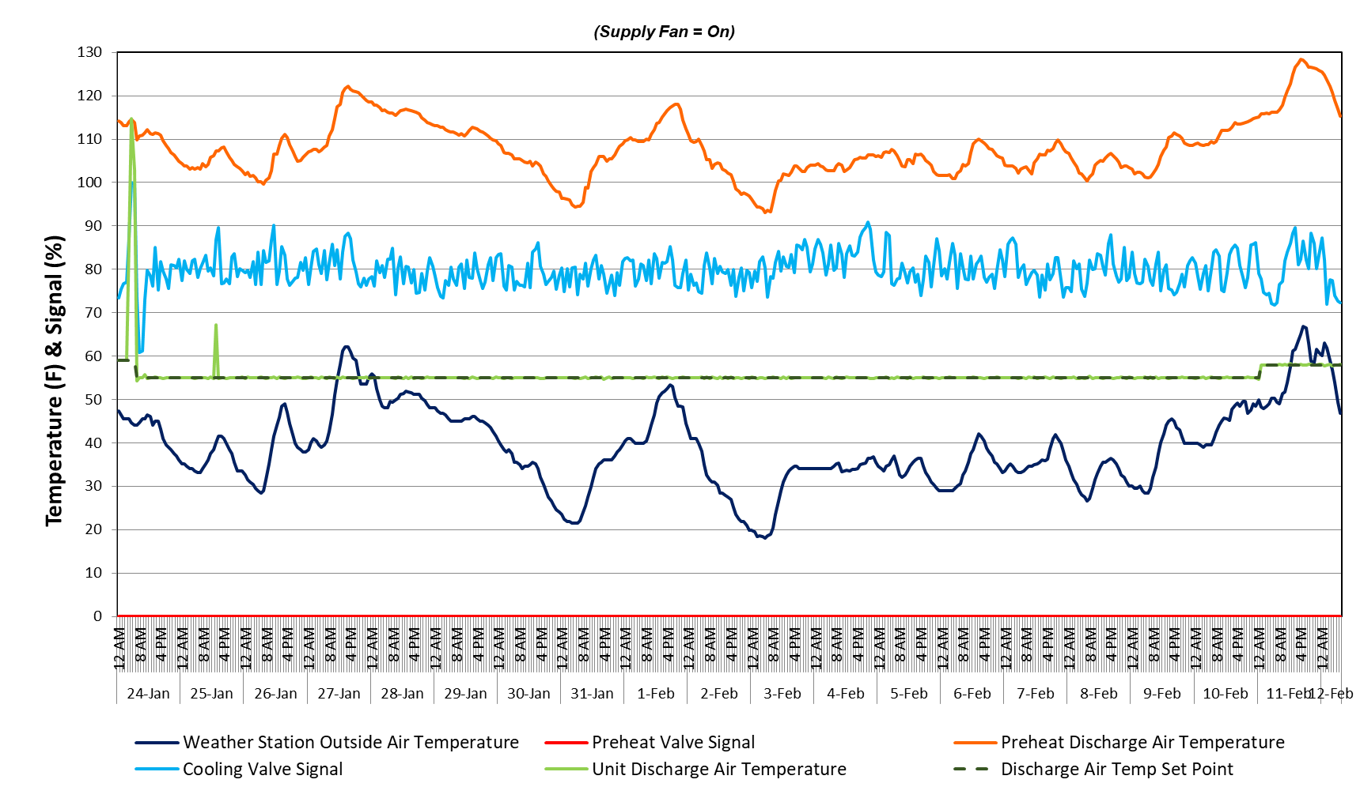
AHU Simultaneous Heating & Cooling:
Leaking Preheat Valve
Preheat Discharge Temp 70°F > Outdoor Air Temp
Preheat Discharge Temp 50°F > Unit Discharge Temp
Preheat Valve Signal = 0%, Closed
Fault: Temp rise across heating coil despite closed valve
Notes:
Root cause: Leaking PH Valve Remediation: Repair/Replace Valve Insidious: Issue likely undetected because people in spaces would still feel comfortable & unit is meeting DAT_SP. BC we have temperature data from the intermediate temp sensors we can find these wasted BTUs!!

Slide 13



How good was our hunt?
How good was our hunt?
Annualized Estimated Energy Savings:
  10.5 billion BTU
  $93,000 Savings
  700 Metric Tons CO2
Notes:
22,300 CFM, 24/7 operation

Slide 14
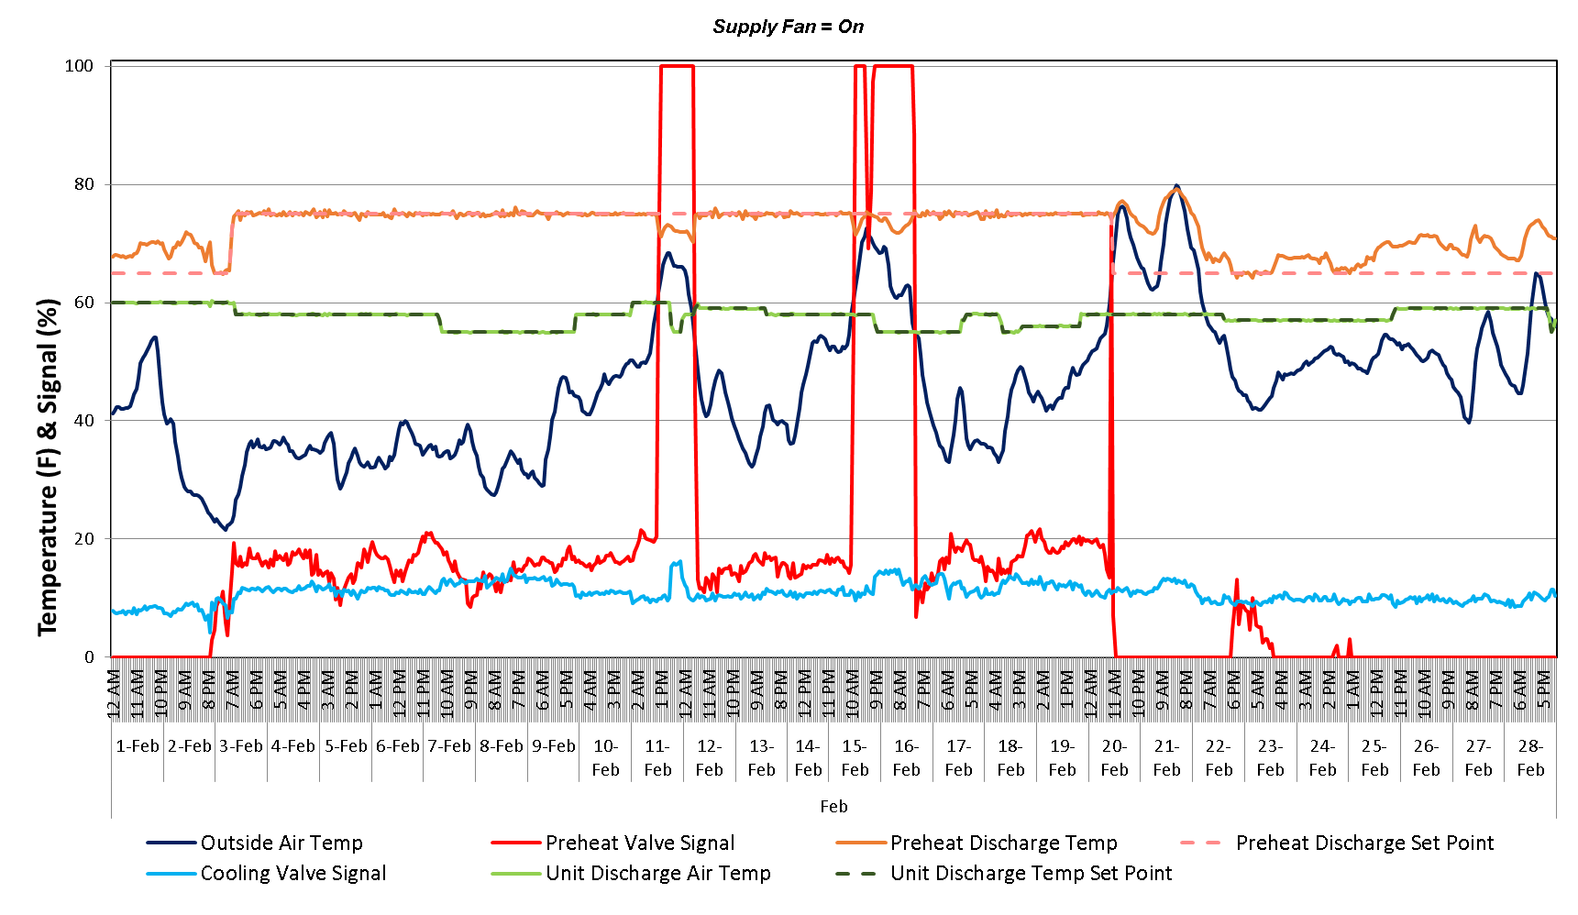
AHU Simultaneous Heating & Cooling:
Set Point Disagreement
Preheat Temp 30°F > Outside Air Temp
Preheat Discharge Temp 20°F > Unit Discharge Temp
Preheat & Cooling Valves modulating at same time
Fault: Simultaneous Valve Operation
Notes:
Fault detected: Valves @ same time Root cause: Underlying set point disagreement. Remediation: Fix Heating discharge temp set point

Slide 15
How good was our hunt?
Annualized Estimated Energy Savings:
  4 million BTU
  $3,500 Savings
  26 Metric Tons CO2
Notes:
Unit 5,680cfm. Issue is seasonal.

Slide 16
Simultaneous Heating & Cooling:
Common Root Causes
Leaking valve
Setpoint disagreement
High valve signal oscillation
Cross contamination
Temperature sensor calibration
Competing space requirements
Notes:
Other ROOT CAUSES resulting in SH&C faults…..

Slide 17
BTU = Energy
BTU = 1.08 × ΔT × Flow × Hrs
temperature differential
air flow
TMY3 hours
Notes:
Transition to looking at air flow. All agree that when send air out of a building, needs to be replaced with conditioned air. Reduce the volume of conditioned air being sent out you are in turn minimizing the amount being generated. Normal temperature control operation, but adjust how much is being wasted.

Slide 18
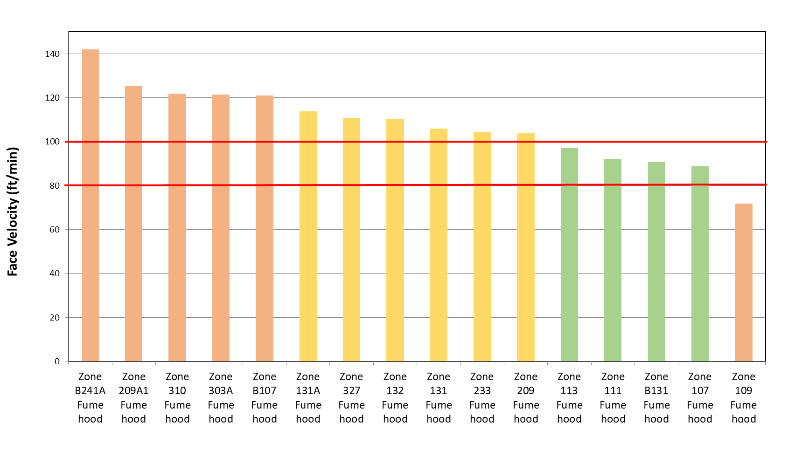
Fume Hood: Face Velocity
Face Velocity Low Limit Threshold
80 ft/min
Face Velocity High Limit Threshold
100 ft/min
Fault: Face Velocity outside site thresholds
Notes:
Root cause; airflow through hood

Slide 19
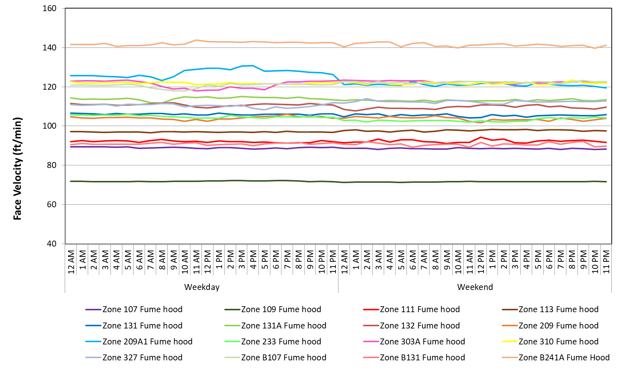
Fume Hood:
Face Velocity & Lab Occupancy
Occupancy Setback
Flat line = No Setback
Fault: Constant Face Velocity
Notes:
Occupancy behavior, sensor

Slide 20
How good was our hunt?
50 Fume Hoods evaluated
Air Flow & Face Velocity Optimization
  126 million BTU
  $2,600 Savings
  9 Metric Tons CO2

Slide 21
Root Cause Analysis & Faulty Data
Faults: Air Flow ≠ Set Point & Velocity Alarming
The velocity alarm oscillated inconsistently with airflow readings.
Airflow readings oscillated and were zero for hours at a time

Slide 22
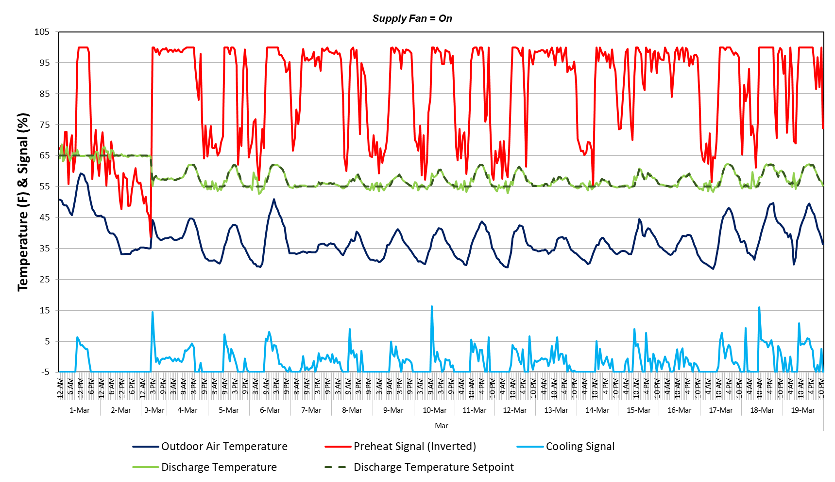
Data Insufficiency
Fault: Simultaneous Valve Operation
Without a mixed air, preheat discharge air, or cooling discharge air temperature, the root cause & degrees of excess heating and cooling cannot be determined

Slide 23
Data Sufficiency
ASHRAE recognizes the importance of BMS data sufficiency
How do you know you have the data needed to calculate energy savings?
  ASHRAE Guideline 36
  Realizing energy savings is dependent on data quality as well as the labor & initiative to carry out the needed system changes
Notes:
&

Slide 24
Questions & Answers
Julianne Rhoads
Senior Analyst
jrhoads@cimetrics.com
(617) 350-7550 ext. 221
Lisa Zagura
Senior Analyst
lzagura@cimetrics.com
(617) 350-7550 ext. 219
Mary Ellen Cantabene
Chief Operation Officer
mcantabene@cimetrics.com
(617) 350-7550

